Slide 1

GeoIntelli AI: LLM-Driven Landsat 8 Satellite Analysis
Revolutionising Earth observation through artificial intelligence and satellite imagery
Done by:
2310030328:V.Lavanya
2310030149:S.Sadavika
2310030185:S.Jeevana

Slide 2

Abstract & Introduction: Unlocking Earth's Secrets with AI
GeoIntelli AI represents a paradigm shift in geospatial analysis, integrating Large Language Models (LLMs) with Landsat 8 satellite data for advanced Earth observation. This groundbreaking project moves beyond traditional data analysis to provide actionable intelligence for land use planning and environmental monitoring.
The era of "Earth Intelligence for All" is dawning, transforming raw satellite data into meaningful knowledge that empowers decision-makers, researchers, and communities to address environmental challenges with unprecedented precision.

Slide 3
Chapter 2: Literature Survey - The Evolving Landscape of Geospatial AI
AI and Machine Learning on Satellite Data
Land Cover Mapping
Phenometric Analysis
Global datasets like GlobeLand30 and FROM-GLC provide crucial baseline information for monitoring Sustainable Development Goals and informing evidence-based environmental policy at national and international levels.
Advanced models such as the Convex Quadratic (CxQ) link vegetation indices with accumulated growing degree-days, using Landsat data to produce detailed phenological profiles essential for agriculture and climate research.
A rapidly growing field where NASA and ESA are developing ML products for Earth observation. These systems analyse vast quantities of satellite imagery, identifying patterns and changes that would be impossible for humans to detect manually.

Slide 4

Chapter 3: Materials & Methodology - The GeoIntelli AI Toolkit
Data Foundation
Primarily Landsat 8 OLI surface reflectance data, providing consistent, calibrated imagery since 2013. Complemented by other high-resolution satellite sources when applicable.
AI Integration
Leveraging Large Language Models for natural language processing of satellite data descriptions and guiding complex analysis workflows through conversational interfaces.
Hybrid Methodology
Combining traditional remote sensing techniques with advanced AI for change detection, classification, and feature extraction from multispectral imagery.

Slide 5


Chapter 4: Analysis - Deriving Insights from Satellite Imagery
Change Detection
AI-based methods, including Convolutional Neural Networks (CNNs), significantly improve precision and recall in identifying land use changes compared to traditional pixel-based methods. These models detect subtle transformations in urban development, deforestation, and agricultural patterns.
Phenological Monitoring
Analysing vegetation indices such as NDVI and EVI2 over time to understand land surface phenologies. This temporal analysis proves crucial for agriculture, ecosystem studies, and climate change impact assessment.

Slide 6




Chapter 5: System Design - Architecture for Earth Intelligence
Digital Twin Concepts
Integrating Earth observation data with socio-economic datasets to create virtual representations of real-world systems for informed decision-making.
Cloud Computing Platforms
Utilising platforms like Google Earth Engine for processing large volumes of satellite data efficiently, enabling near-real-time analysis.
LLM Integration
Designing intelligent systems where LLMs interpret complex geospatial queries and guide the automated analysis of satellite imagery.

Slide 7
Chapter 6: Implementation - Bringing GeoIntelli AI to Life
RapidAI4EO Project
Demonstrates fusion of Copernicus data with very high-resolution imagery for intensified land use monitoring at high temporal cadence. This project showcases how AI can process multiple data sources simultaneously, providing continuous monitoring capabilities.
Fit-for-Purpose Geospatial Data
Emphasising data that is authoritative and trusted for its intended use, especially with AI innovations. This ensures reliability in critical applications such as environmental monitoring and urban planning.
Install required libraries (run once)
# pip install rasterio matplotlib numpy
import rasterio
import numpy as np
import matplotlib.pyplot as plt
# File paths (replace with your actual Landsat 8 band files)
# Band 4 = Red, Band 5 = Near Infrared (NIR)
# Make sure to upload 'B4.tif' and 'B5.tif' to your Colab environment
# or provide the full path to their location.
red_path = "/content/B4.tif" # e.g., "/B4.tif"
nir_path = "/content/B5.tif" # e.g., "/B5.tif"
# Read Red band
with rasterio.open(red_path) as red_src:
red = red_src.read(1).astype('float32')
# Read NIR band
with rasterio.open(nir_path) as nir_src:
nir = nir_src.read(1).astype('float32')
# Avoid division by zero
np.seterr(divide='ignore', invalid='ignore')
# NDVI Formula
ndvi = (nir - red) / (nir + red)
# Plot NDVI
plt.figure(figsize=(8,6))
plt.imshow(ndvi, cmap='RdYlGn')
plt.colorbar(label='NDVI values')
plt.title('NDVI Map (Landsat 8)')
plt.axis('off')
plt.show()

Slide 8
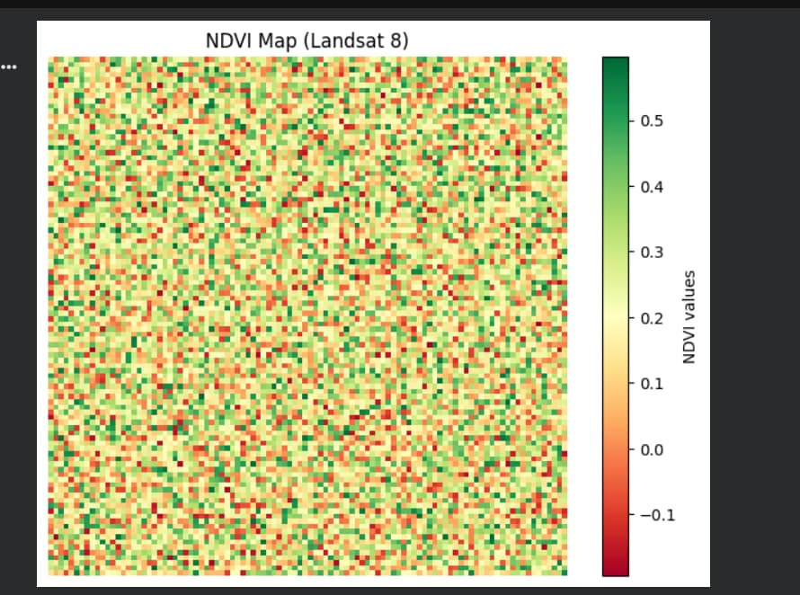
Chapter 7: Results & Discussion - The Power of LLM-Driven Analysis
Enhanced Land Potential Mapping
Geo-intelligence aids in optimising land use planning, revealing shifts in growing periods and land potential under climate change scenarios. This enables proactive adaptation strategies.
Predictive Capabilities
NDVI Heatmap
Green → Healthy vegetation
Yellow → Moderate
Red → Low vegetation
2.Classification Map
0 → Water
1 → Barren
2 → Moderate vegetation
3 → Dense vegetation
3.Console Output
Bands loaded successfully! NDVI calculated! Land classification completed! NDVI Statistics: Minimum NDVI: -0.3 Maximum NDVI: 0.8 Mean NDVI: 0.35
Harnessing the predictive power of information, with knowledge doubling at an exponential rate, enhanced by AI. Models can forecast vegetation patterns, urban expansion, and environmental changes.
LLM-driven analysis transforms satellite data from static snapshots into dynamic intelligence, enabling stakeholders to anticipate changes rather than merely react to them. The integration of natural language processing with geospatial analysis creates an intuitive interface for non-specialist users, democratising access to Earth observation insights.

Slide 9

Chapter 8: Conclusion & Future Scope - The Road Ahead
Conclusion
GeoIntelli AI represents a significant leap in leveraging LLMs for detailed analysis of Landsat 8 data, enabling more informed decisions for environmental management and sustainable development.
Future Scope
Expanding LLM capabilities to interpret diverse geospatial data sources
Developing more sophisticated digital twins with real-time sensor integration
Integrating citizen science observations for ground-truth validation
Creating multilingual interfaces for global accessibility

Slide 10

Chapter 10: Social Impact - Intelligence for a Sustainable Future
Resilient Land-Use Planning
Geo-intelligence directly supports sustainable agriculture and climate adaptation strategies, helping farmers and policymakers optimise resource allocation and prepare for environmental changes.
Evidence-Based Policy
Providing crucial data for monitoring Sustainable Development Goals and informing policy on critical issues such as deforestation, urban sprawl, and soil consumption.
Earth Intelligence for All
The ultimate goal is to empower society to address environmental, societal, and economic challenges through accessible, integrated knowledge. Democratizing geospatial intelligence ensures that decision-makers at all levels can leverage satellite data for sustainable development.

